Slide 1




Digital Portfolio
STUDENT NAME: K Madesh
REGISTER NO AND NMID: 24g219
DEPARTMENT: 2nd yr bsc-cs “c”
COLLEGE: a.m.jain college meenambakkam

Slide 2
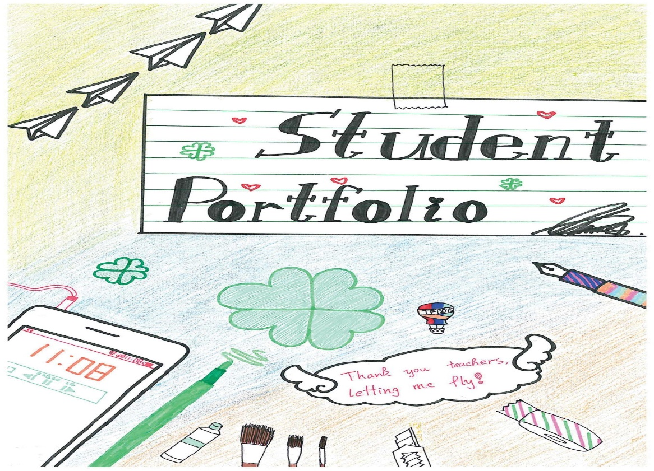
Project title
STUDENT PORTFOLIO

Slide 3



AGENDA
Project Overview
End Users
Tools and Technologies
Problem Statement
Portfolio design and Layout
Features and Functionality
Results and Screenshots
Conclusion
Github Link
This Photo by Unknown Author is licensed under CC BY-SA

Slide 4
PROBLEm STATEMENT
Identifying the Gap
Freshers and students often struggle to present their skills and projects professionally.
Traditional resumes lack interactivity and may not reflect a candidate’s tech creativity.
Recruiters often don’t have time to read lengthy resumes.
Need for a Solution
A portfolio website provides a dynamic and personalized way to
showcase:
Technical skills
Real-time projects
Self-learning efforts
Design thinking and presentation ability

Slide 5

PROJECT OVERVIEW
Purpose:
To build an interactive, online portfolio that acts as a digital resume.
To reflect my journey, projects, and learning in a structured, professional format.
Key Objectives:
Make it simple, modern, and informative
Deploy the site online using GitHub Pages
Present a project-centric and skill-oriented identity

Slide 6

WHO ARE THE END USERS?
1. RECRUITERS/EMPLOYES :
Review skills and project work during hiring process
Evaluate both technical and design knowledge
2. PEERS AND MENTORS :
Provide feedback
Collaborate on open-source or academic projects
3.ACADAMIC INSTRUCTORS :
Assess practical implementation of skills
Validate course outcomes
4. PERSONAL USE:
Track career progress
Keep all achievements and work in one place
This Photo by Unknown Author is licensed under CC BY-NC

Slide 7

TOOLS AND TECHNIQUES
TECHNOLOGIES :
Frontend Languages: HTML5, CSS3
Programming Languages: Java, Python (used in projects)
Design: CSS Flexbox & Grid for layout, Google Fonts for typography
DEVELOPMENT TOOLS :
VS Code: Main code editor
Git & GitHub: Version control and collaboration
GitHub Pages: For free and reliable website hosting
BEST PRATICES FOLLOWED :
Clean code structure
Mobile responsiveness
Semantic HTML for accessibility

Slide 8

PORTFOLIO DESIGN AND LAYOUT
DESIGN PRINCIPLES:
Minimalistic UI: Focus on readability and user experience
Consistent Layout: Uniform margins, font sizes, and color schemes
Sectional Division: Each section is clearly marked (About, Skills, Projects)
COLOR SCHEME & FONTS:
Primary Color: Light blue – indicates trust and calmness
Secondary Color: White – clean background for readability
Typography: Clean sans-serif fonts for modern appearance
RESPONSIVENESS:
Designed to adapt to different screen sizes (mobile, tablet, desktop)
8

Slide 9
FEATURES AND FUNCTIONALITY
CORE FEATURES:
About Me Section: Personal introduction and motivation
Skills Section: Represented as interactive tags (Java, Python, CSS)
Projects Section: Project titles and descriptions displayed neatly
Navigation: Smooth scroll and clear flow of content
EXTRA FUNCTIONALITIES:
Mobile Friendly: Works on smartphones and tablets
Fast Loading: No backend or heavy libraries
Version Controlled: Easy to update and maintain via GitHub

Slide 10
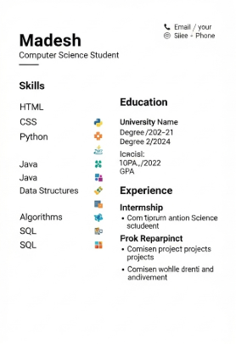
RESULTS AND SCREENSHOTS
3/21/2024 Annual Review
10

Slide 11
CONCLUSION
IMPACT :
A personal portfolio helps in standing out from the crowd in technical interviews
Reflects professionalism, consistency, and strong communication
FUTURE SCOPE :
Add blog section to document learning
Integrate contact form or links to LinkedIn/GitHub
Include more projects with live demos and GitHub links
11

